Slide 1








FBS-Radar: Uncovering Fake Base Stations at Scale in the Wild
Feb. 26 – Mar. 1
Zhenhua Li
Weiwei Wang
Christo Wilson
Jian Chen
Chen Qian
Taeho Jung
Lan Zhang
Kebin Liu
Xiangyang Li
Yunhao Liu
lizhenhua1983@gmail.com
http://www.greenorbs.org/people/lzh/
Mar. 1st, 2017
Notes:
Hi everyone, in this talk I’d like to tell you some astonishing stories about fake base stations,
and share with you our long-term struggling experiences against fake base stations.
This is a joint work of Tsinghua University, Baidu Mobile Security, UCSC, and so forth. I’m the 1st author, and our another author Chen Qian is also here.

Slide 2
Outline
1
Background
2
State of the Art
3
Our System
4
Locating FBSes
5
Summary
Notes:
This is the outline of my presentation. First, let’s look at the background with two stories.

Slide 3




Story 1
SMS Text Message
From 95599 (Agriculture Bank of China):
We’re processing the student loan you’ve applied for, and now requiring you to transfer a deposit of ¥9900 (≈$1500) to the bank account XXXXXXXXX.
* Note: This is a simplified version of the actual story which involves more complex details.
Notes:
Story 1: In last year’s August, an 18-year-old girl entered a Chinese university as an undergraduate freshman. She came from a poor village, and she applied for a student loan from the Agriculture Bank of China.
Several days later, her cellphone received a text message from 95599, which is the official phone number of the Agriculture Bank of China. The message says: … On getting this message, the girl happily transferred almost all her savings to the designated bank account.
Before long, she realized that the Agriculture Bank of China had never sent her any message and thus she was cheated.
A couple of days later, she died because of the deep sorrow and regret. Obviously, this is a tragedy, but not the only tragedy.

Slide 4

Story 2
SMS Text Message
From 95566 (Bank of China):
We’re processing the house mortgage for you. Please prepare ¥17,600,000 (≈$2,600,000) ...
Fake Base Stations
* Note: This is a simplified version of the actual story which involves more complex details.
Notes:
A couple of days later, a professor working at Tsinghua University, yes, my colleague, was cheated again by a similar message.
It seemed that the message came from the Bank of China about a house mortgage
This time, the professor lost more than 17 million Chinese yuan, that is around 2.6 million US dollars, all the savings of her family.
Thankfully, the professor is very tough and she didn’t become a photo.
Nowadays, cybercrime is pervasive. Meanwhile, people are becoming much more alert than ever.
However, when the cyber attacks are launched by certain entities that behave pretty like officials and authorities, people can be easily deceived. In the two stories, such entities are called fake base stations.

Slide 5
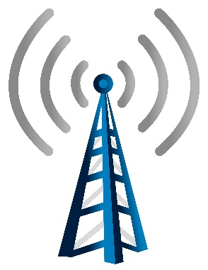

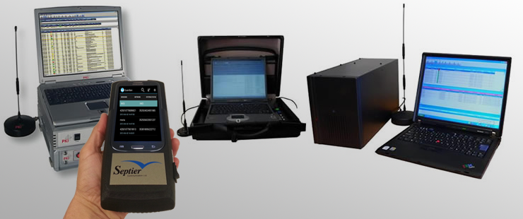
GSM (Global System for Mobile Communication)
 | Birth Year | User Scale | Speed | Security
2G – GSM | 1990 | > 1 billion | Low | Poor
3G – CDMA | 2008 | < 2 billion | Middle | Middle
4G – LTE | 2009 | ≈ 3 billion | High | Fine
authentication
X
Fake Base Stations
Notes:
Historically, fake base stations stem from a simple vulnerability of the 2G GSM cellular protocol, where only base stations can authenticate user devices, but NOT vice versa.
As a result, a number of companies have manufactured numerous types of fake base stations.

Slide 6
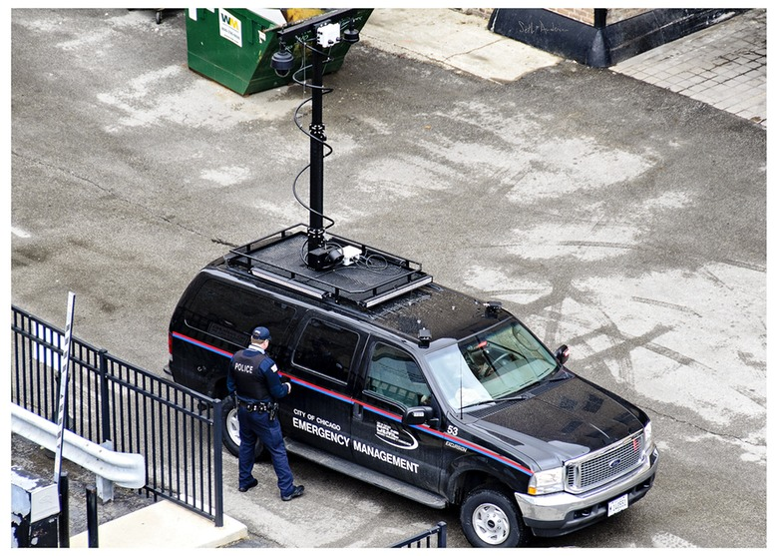
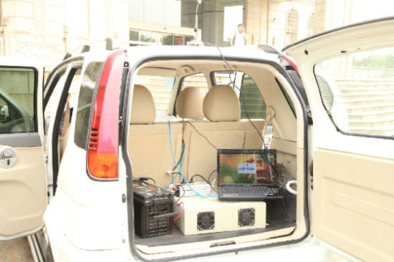
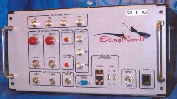
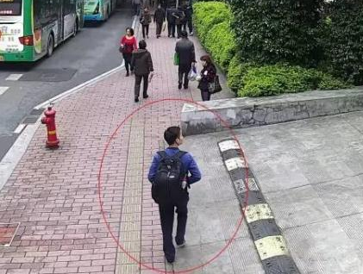
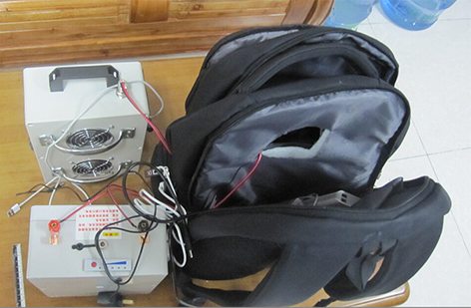
FBS Carrier
Very high signal strength
Notes:
In the very beginning, fake base stations were only used in military battlefields by governments, or used in counter-terrorist scenarios by law enforcement agencies.
As time goes by, fake base stations were gradually revealed to unauthorized organizations.
In particular, criminal gangs were using fake base stations to set up their own GSM cell towers with very high signal strengths.
Nearby users’ cellphones are quite likely to attach to them.
Additionally, criminal gangs have been improving the techniques of fake base stations, to make them more lightweight, more portable, and more mobile. At the moment, a fake base station can be well accommodated by a small backpack.

Slide 7
Fake Base Station (FBS)
Notes:
Technically, a typical fake base station is made up of three components: a GSM wireless transceiver, an engineering laptop, and an engineering cellphone.
Of course, the wireless transceiver is the core component. It can simulate many functions of a legitimate GSM base station.
The engineering laptop controls the wireless transceiver by tuning the radio frequency, adjusting the signal strength, setting the BS ID, and most importantly, forging the sender’s phone number. This is why the two victims in the two stories received fraud messages from authoritative phone numbers.
In addition, the engineering cellphone is used to search for nearby legitimate BSes and record their wireless parameters.

Slide 8
FBS Attack on GSM Phones
- 70 dBm
- 100 dBm
Current Connection
Which BS has the highest signal strength?
- 60 dBm
I may have to switch my BS connection …
- 30 dBm
Location Update
GSM
Notes:
In detail, a typical FBS attack on GSM cellphones works in three steps.
Suppose the user’s cellphone is currently connected to a legitimate base station at the top left.
In the first step, the fake base station sends a Location Update message to the cellphone.
On receiving the message, the cellphone thinks that: I have entered a new location, so ….
Since there are three new base stations available, the major selection criteria is …? （动画）
Obviously, the FBS has the highest signal strength which can be even harmful to human health.
So in the 3rd step, the cellphone disconnects with the legitimate BS and sets up a new connection with the FBS.

Slide 9
FBS Attack on GSM Phones
- 70 dBm
- 100 dBm
New Connection
- 60 dBm
- 30 dBm
GSM
Notes:
In detail, a typical FBS attack on GSM cellphones works in three steps.
Suppose the user’s cellphone is currently connected to a legitimate base station at the top left.
In the first step, the fake base station sends a Location Update message to the cellphone.
On receiving the message, the cellphone thinks that: Well, it seems I have entered a new location, and thus ….
Since there are three new base stations available, the major selection criteria is …? （动画）
Definitely, the FBS has the highest signal strength which can be even harmful to human health.
So in the 3rd step, the cellphone disconnects with the legitimate BS and sets up a new connection with the FBS.

Slide 10

FBS Can Also Impact 3G/4G Phones
Jamming Signal
3G/4G
GSM
Degrade
GSM
GSM has existed for many years, so abandoning GSM also needs many years …
Notes:
At this point, I guess some of you may think that: I’m using a 3G/4G cellphone, so I’m immune to FBSes.
Unfortunately, this is not the truth, because today’s FBSes can send jamming signals that force nearby GSM-compatible 3G/4G cellphones down to the GSM mode.
Note that … from now on.

Slide 11
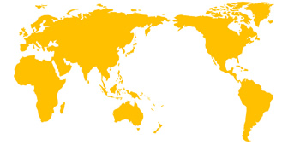

FBS Attack Is NOT Hypothetical
UK
Russia
☜
US
China
India
Year | # FBS Msgs
2013 | >> 2.9 billion
2014 | >> 4.2 billion
2015 | >> 5.7 billion
N * billion
Notes:
FBS attack is NOT hypothetical: to date, it has been observed in the US, China, India, Russia, and the UK.
In China alone, mobile users received billions of messages from FBSes every year, causing economic loss of billions of dollars.

Slide 12

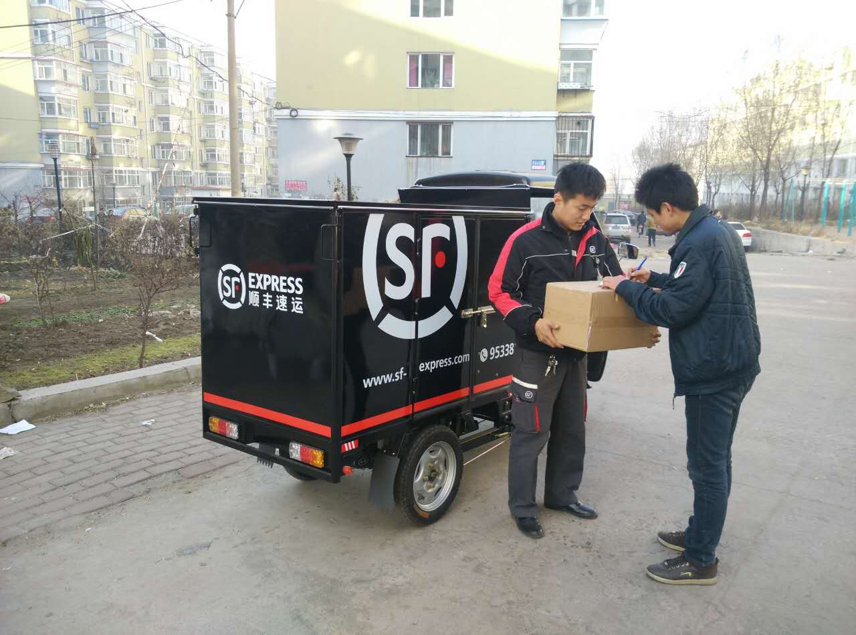
FBS Industry in China
Device: $400
Daily income: $40
Device: $1000
Daily income: $70
Device: $700
Daily income: up to $1400
Notes:
As a matter of fact, there is a large-scale FBS industry in China. Surprisingly, an attacker with a $700 FBS device can earn up to $1400 in one day.
This is much more cost-effective than doing similar legal jobs.
So, breaking bad is actually difficult when there are huge benefits.

Slide 13

FBS Industry in China
Device: $400
Daily income: $40
Device: $1000
Daily income: $70
Device: $700
Daily income: up to $1400
Notes:
As a matter of fact, there is a large-scale FBS industry in China. Surprisingly, an attacker with a $700 FBS device can earn up to $1400 in one day.
This is much more cost-effective than doing similar legal jobs.
So, breaking bad is actually difficult when there are huge benefits.

Slide 14
2
State of the Art
Notes:
In the past a few years, China’s governments have made various efforts to detect FBSes.

Slide 15


Electronic Fence
Huge infrastructure costs → Poor scalability
Notes:
The first method is called Electronic Fence, that is to deploy a number of cellular sensors within a specific area to capture high-strength cellular signals from FBSes.
This method is very effective, but not scalable, because it requires huge infrastructure costs.

Slide 16
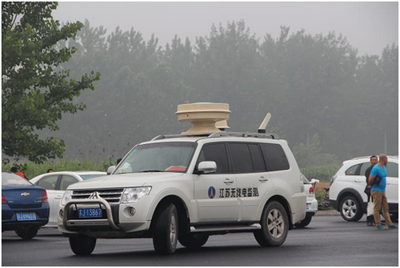
FBS-signal Detection Car
Random walk → Limited coverage & “dull”
Notes:
To detect FBSes in a dynamic manner, mobile carriers often employ dedicated FBS-signal detection cars to patrol along major streets.
However, this random-walk method is limited in coverage, and FBSes can be easily moved away from major streets or simply shut down when approaching major streets.

Slide 17
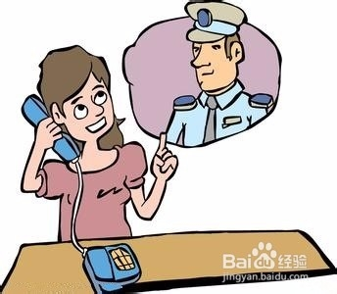
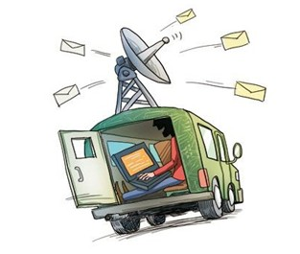
User Reporting
Dial 12321
Most users don’t realize the existence of FBSes
Notes:
In addition, China’s governments encourage users to report suspicious FBSes by dialing 12321.
However, most users in China do not realize the existence of FBSes at all, making this method generally useless.

Slide 18

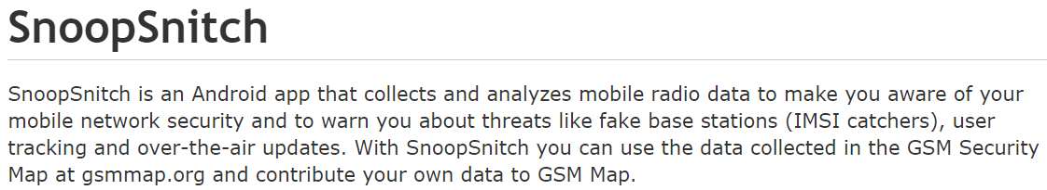
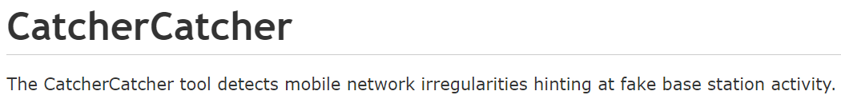
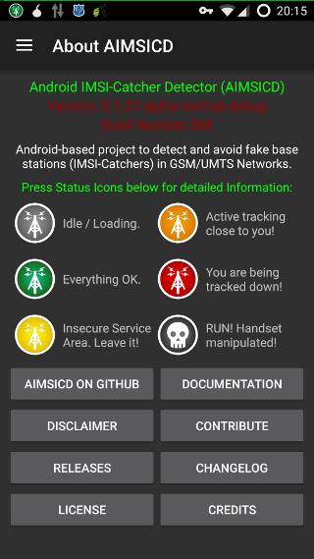

Client-side Tools
Do they really work in large-scale practice? …
Notes:
In academia, a few preliminary technologies have been recently proposed to detect FBSes, e.g., by developing client-side tools.
Our question is: Do they really work in large-scale practice?

Slide 19
3
Our System:
FBS-Radar
Notes:
In order to understand and counter-attack FBSes at scale in the wild, we deployed a real-world system called FBS-Radar.

Slide 20
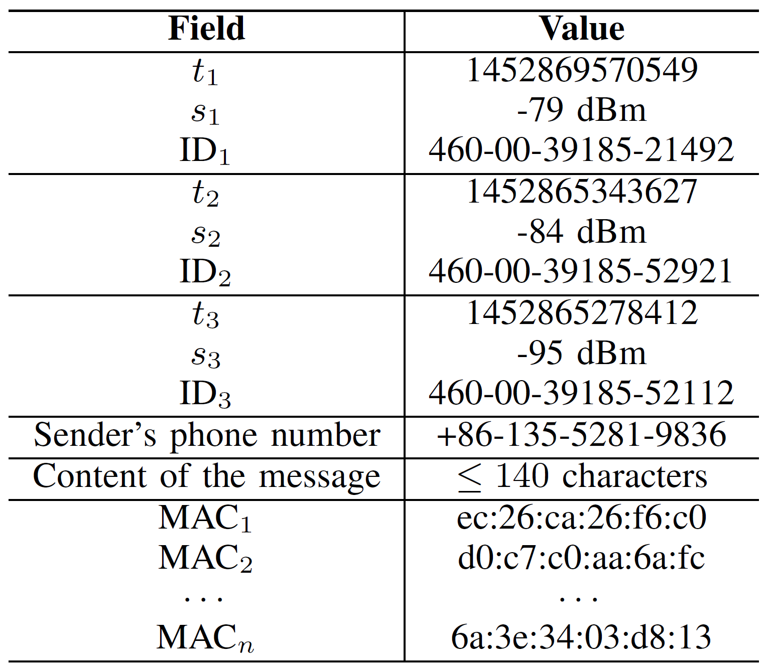
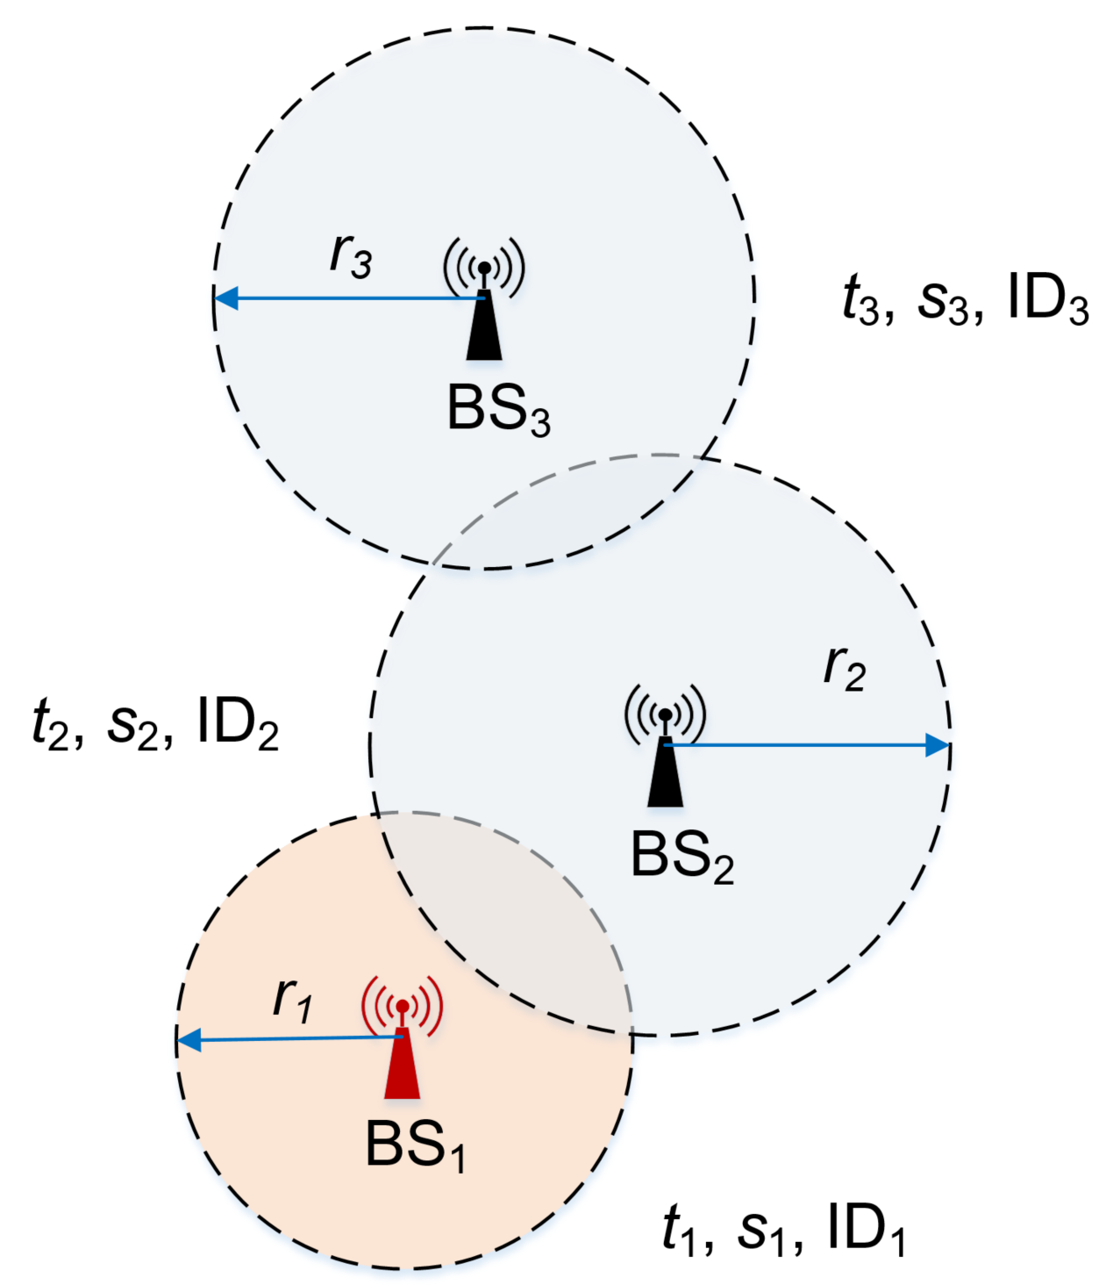
Baidu PhoneGuard Users Opt-in
Sender’s number is not in the recipient’s contact list
Sender’s number is an authoritative number
Report multiple fields of suspicious SMS messages
Notes:
To obtain a large user base for FBS-Radar, we utilized a very popular mobile app called Baidu PhoneGuard.
We asked PhoneGuard users to opt-in: whenever a suspicious message arrived at their cellphone, the message and its metadata were reported to our cloud, as well as information about the recent BS connections and nearby WiFi Access Points.
Here we define a message to be suspicious if the sender’s number is not in the recipient’s contact list, or the number is an authoritative number.

Slide 21
Five Methods
1. Signal Strength Examination
2. BS ID Syntax Checking
3. Message Content Mining
4. BS-WiFi Location Analysis
5. BS-Handover Speed Estimation
0.23%
0.39%
0.15%
~100M users
0.16%
4.1%
Notes:
Using the crowdsourced data from nearly 100M users, we comprehensively explored a variety of methods for detecting FBSes, and finally found five methods that are really effective.

Slide 22
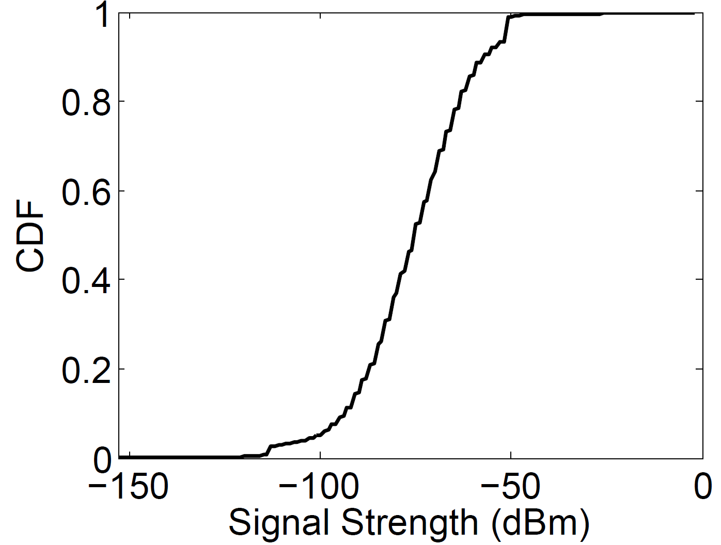
3.1 Signal Strength Examination
☜
-40 dBm
0.23% of user-reported suspicious SMS messages
Notes:
First, through signal strength examination, we find that 0.23% of suspicious messages were associated with unreasonably high signal strength.
However, this is a very conservative method because most cellphones affected by the FBS perceive a reasonable signal strength.
Although the FBS is using an extremely high signal strength, when the signal reaches a user device, the perceived signal strength may seem reasonable.

Slide 23
3.2 BS ID Syntax Checking
BS ID = MCC + MNC + LAC + CID
MCC: Mobile Country Code, 3 digits
MNC: Mobile Network Code, 2 digits
LAC: Location Area Code, 16 bits
CID: Cell Identity, 16 bits for 2G/3G and 28 bits for 4G
0.15% of suspicious messages were sent by BSes with syntactically invalid IDs
Notes:
Second, by BS ID Syntax Checking, we find that 0.15% of suspicious messages were sent by BSes with syntactically invalid IDs.
This method is very simple and limited, because most FBS operators are not so stupid in setting the ID.

Slide 24
3.3 Message Content Mining
Bag-of-words SVM (Support Vector Machine) classifier trained on 200,000 hand-labeled SMS messages
Labelling suspicious messages;
Word segmentation;
Feature extraction;
Quantizing the feature vector;
Training the SVM model;
Preprocessing the test set;
SVM classification of the test set.
Computation intensive
Violation of user privacy
0.16% of suspicious messages came from authoritative phone numbers and were determined to contain fraud text content
Notes:
Third, by message content mining using a bag-of-words SVM classifier, we find that 0.16% of suspicious messages came from authoritative phone numbers and were determined to contain fraud texts. Clearly, such FBSes are using spoofed phone numbers.
This machine learning method has two shortcomings: 1) it is computation intensive; 2) it needs to analyze the message content so it violates the user privacy.

Slide 25
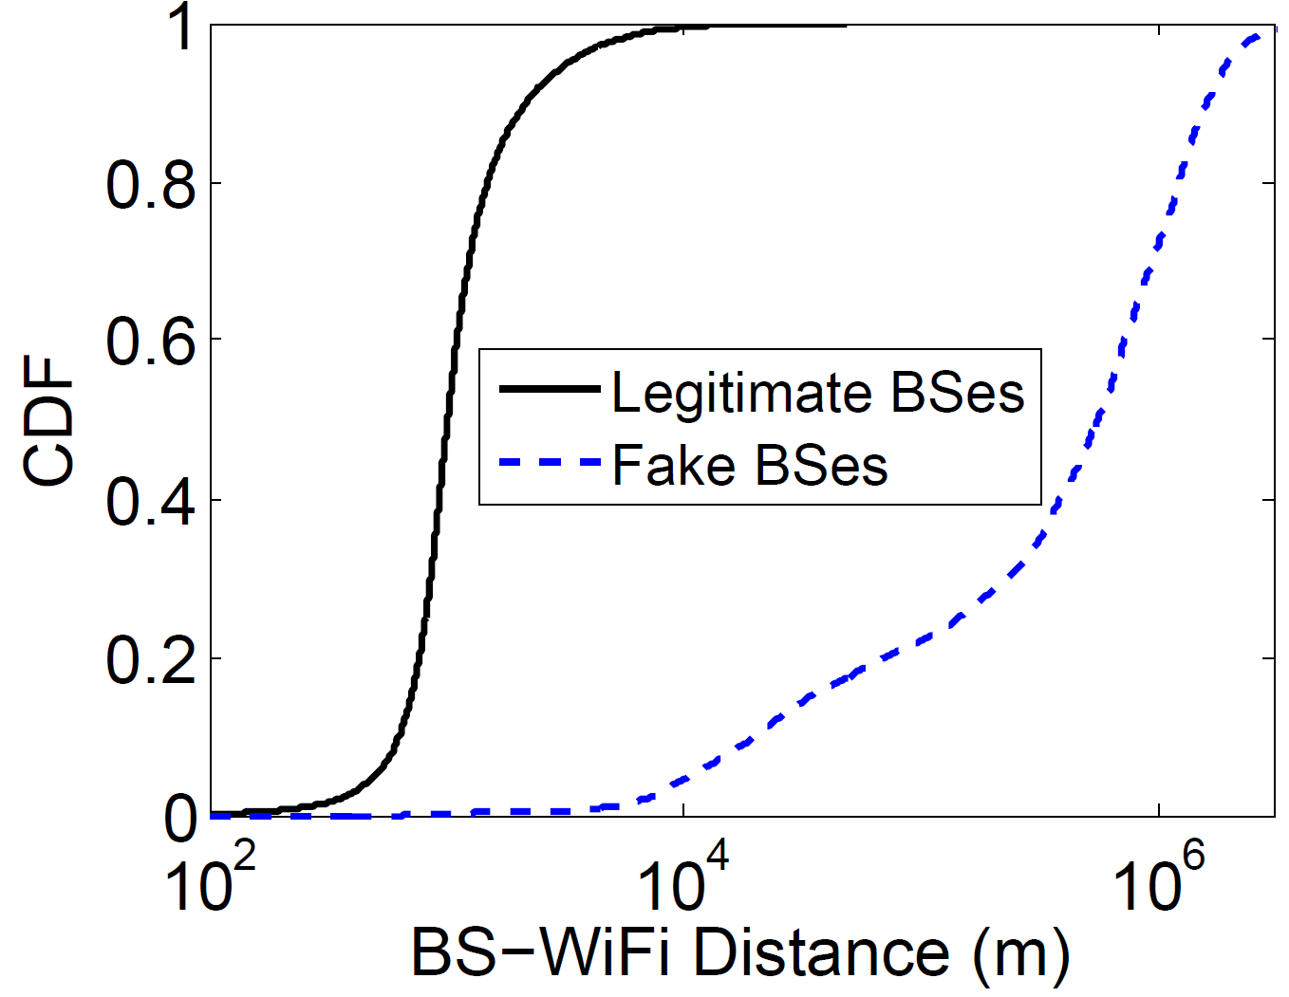
3.4 BS-WiFi Location Analysis
BS Location
User WiFi Location
4.1% of suspicious messages were sent by BSes that were not in their correct geolocation, i.e., they were spoofing the ID of a legitimate but distant BS.
Notes:
The 4th method is called BS-WiFi Location Analysis. For every message, we first map the currently connected base station’s ID to its claimed location. Note that every legitimate BS ID is associated with a fixed location.
Second, we determine the user’s location based on nearby WiFi APs.
By comparing the two locations, we find a huge gap between legitimate and fake BSes.
Therefore, 4.1% of suspicious messages were sent by BSes that were not in their correct geolocation, i.e., they were spoofing the ID of a legitimate but distant BS. And this is the most effective method.

Slide 26
3.4 Counterfeiting a Nearby BS ID
- 70 dBm
- 100 dBm
My location does not change a lot, so I needn’t switch to a new BS ☺
Current Connection
- 60 dBm
- 30 dBm
If I counterfeit a nearby BS ID …
Location Update
Notes:
At this point, some people may have a doubt like: If I’m an attacker, can I avoid your detection by simply counterfeiting a nearby BS ID?
The answer is: yes, you can! But in this case, user devices will maintain their existing connections to the legitimate cell tower, rather than switch over to the FBS. The cellphone may think that: …

Slide 27
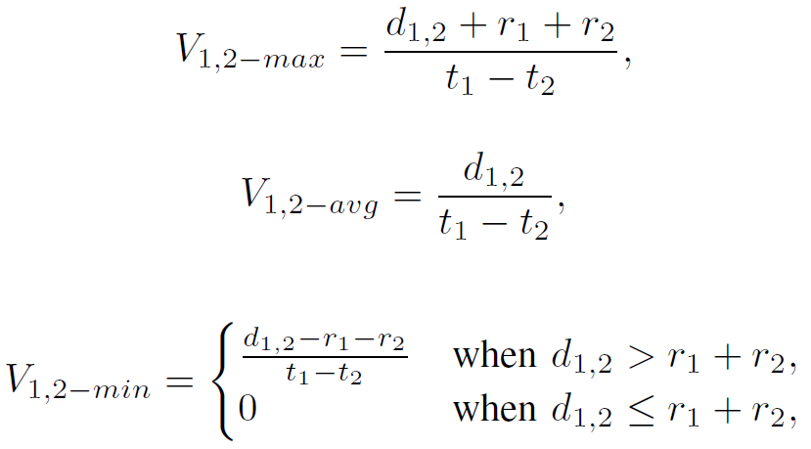
3.5 BS-Handover Speed Estimation
For BS-WiFi location analysis, what if the WiFi location information is not available?
Notes:
Although the 4th method is the most effective, it doesn’t work when the WiFi location information is not available.
In this case, we would use the 5th method called BS-handover speed estimation.
And this is why for every message we require the user to report three consecutive BS connections.
Using these information, we can estimate the maximum, the average, and the minimum BS-handover speed.

Slide 28




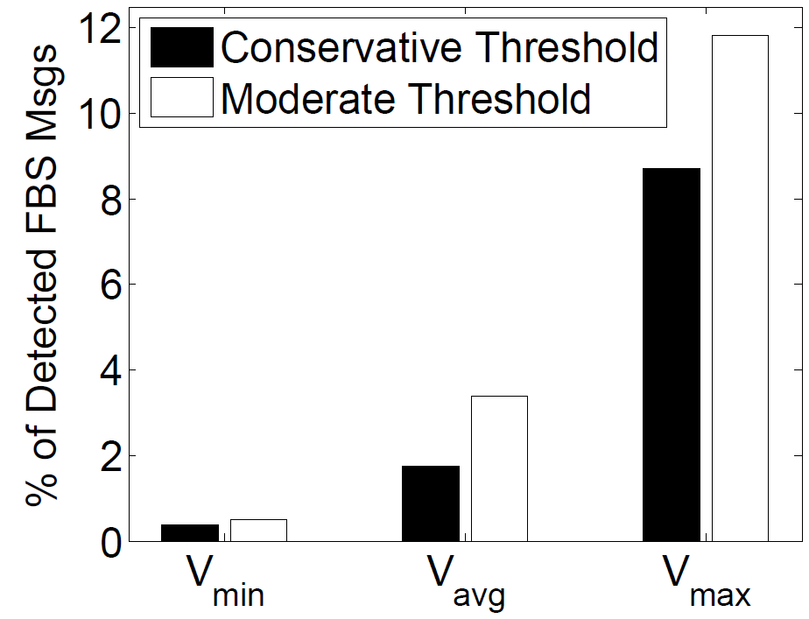
4.5 BS-Handover Speed Estimation
>> 0.39% of suspicious SMS messages come from FBSes
Notes:
Undoubtedly, the BS-handover speed shouldn’t exceed certain thresholds.
To avoid false positives, we use the most conservative threshold, and find at least 0.39% of suspicious SMS messages come from FBSes.

Slide 29
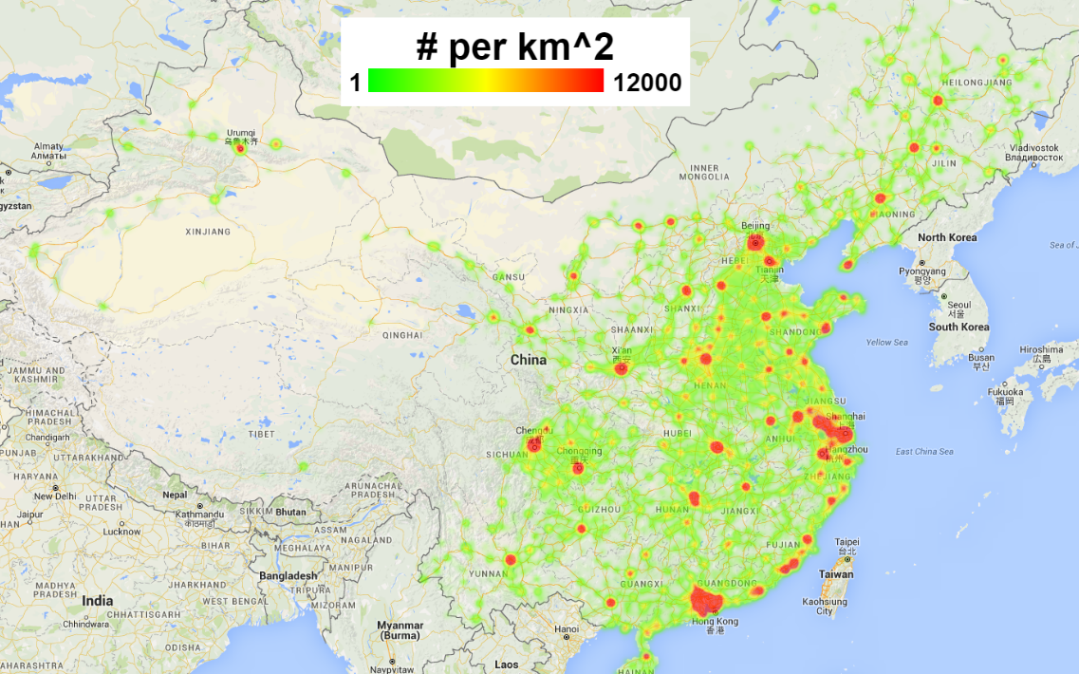
Detection Performance
> 4.7% of suspicious messages should have come from FBSes
- False positive rate is only 0.05% (according to user feedback), mainly due to the inaccuracy of our WiFi database
Set-3 (by message content mining) is >98% covered by the other 4 sets
- No need to collect the text content of users’ messages!
Notes:
In total, we detect ...
Our another important finding is that … !

Slide 30
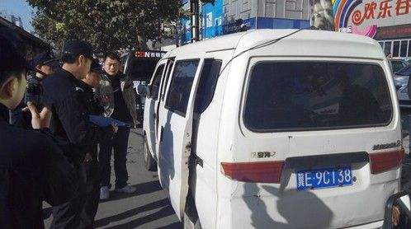
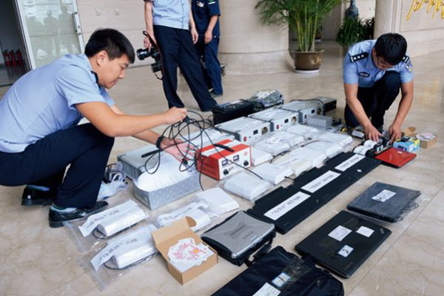
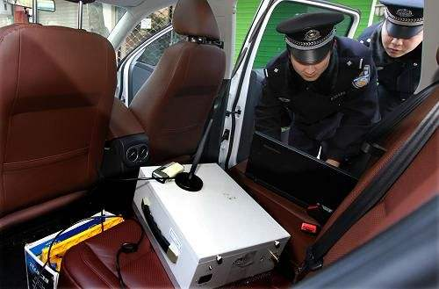
Arresting FBS Operators
With the help of FBS-Radar, the police have arrested tens to hundreds of FBS operators every month
Notes:
Besides identifying FBSes, we also help the police officers arrest FBS operators. To achieve this goal, (翻页)

Slide 31
4
Locating FBSes
Notes:
we need to locate FBSes. In particular, we wish to understand which FBSes are in fact the same one.

Slide 32

Locating FBSes based on User Device Locations
FBSes frequently move and change their IDs
We take both temporal and spatial locality into account
Only those FBS messages
1) using the same BS ID,
2) happening in the same time window,
and 3) located in the same spatial cluster
can be attributed to one FBS.
Notes:
According to our experiences, locating FBSes is indeed a challenging task, because FBSes frequently move and change their IDs.
To this end, we take both temporal and spatial locality of an FBS into account.
Specifically, …

Slide 33
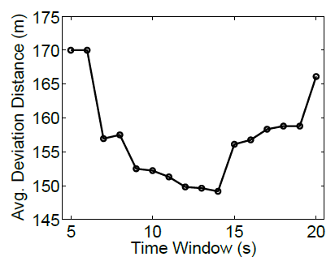
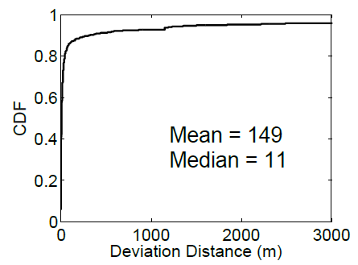

Locating FBSes based on User Device Locations
The centroid of every cluster is the estimated location of an FBS.
☜
This location accuracy is sufficient for us to track FBSes!
Notes:
Now, the key problem is reduced to how large the time window should be.
Truth be told, we haven’t figured out an adaptive method to determine the best time window.
Instead, we take an empirical approach and observe that 14 seconds should be a good choice.
Then, the median location error is just 11 meters.
Although the average location error, 149 meters, seems a bit large, it is still sufficient for the police officers to track FBSes.

Slide 34
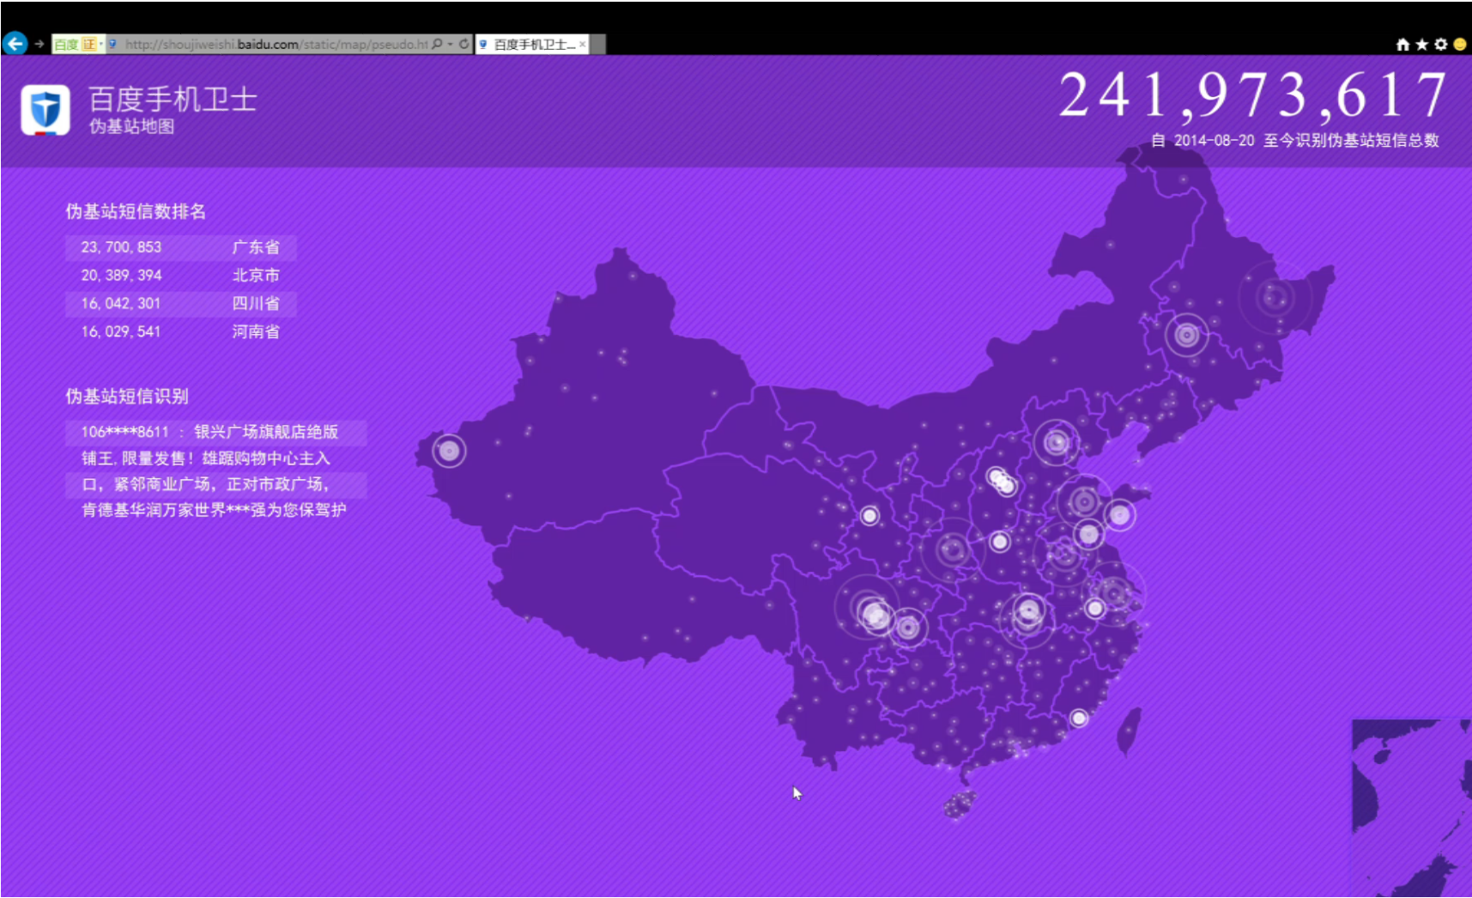
Real-time Locations of FBSes
Public URL → http://shoujiweishi.baidu.com/static/map/pseudo.html
Notes:
To benefit the whole community, we visualize the real-time locations of FBSes through a public URL.
(下面内容用来调整时间)
As demonstrated in this video clip, there are tens to thousands of active FBSes detected by our system at any time.
Since its first launch in August 2014, we have identified over 240 million messages from FBSes.

Slide 35
5
Summary
Using extensive crowdsourced data, we evaluate five different methods for detecting FBSes in the wild, and find that FBSes can be precisely identified without sacrificing user privacy.
We present a reasonable method for locating FBSes with an acceptable accuracy.
FBS-Radar is currently in use by ~100M people. It protects users from millions of malicious messages from FBSes every day, and has helped the authorities arrest numerous FBS operators every month.
Notes:
At last, we summarize our contribution in three folds.
…

Slide 36
Backup slides

Slide 37
FBS Attack: Passive vs. Active
Passive: IMSI-catcher
Rarely reported in China, but sometimes reported in the US
Active: Push spam/fraud SMS messages with spoofed phone numbers
Year | # FBS Msgs
2013 | >> 2.9 billion
2014 | >> 4.2 billion
2015 | >> 5.7 billion

Slide 38

Ground Truth
Our ONLY ground truth comes from users’ feedback
We think this message comes from an FBS. What do you think?
Yes: 99.95%
No: 0.05%
Manual double-check

Slide 39

Why not use GPS?
Most people turn GPS off in most time to save battery, so we have to ask users for GPS privilege
Locattion accuracy increases by 20%?
User scale decreases by 20%? for harassment …

Slide 40
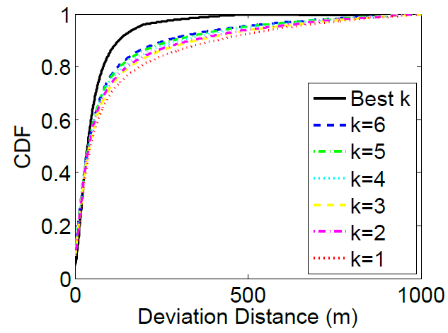
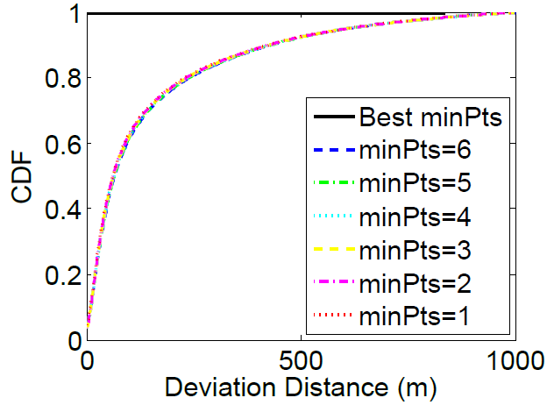
Localizing User Devices based on WiFi Information
The centroid of the dominant cluster is the estimated location of the user device
k-means
DBSCAN

Slide 41
Spam and Fraud SMS Messages
“Dear user, you are lucky to be the winner of this month’s big award! You will be offered 10-GB FREE 4G traffic by clicking on this URL: http://www.10086award.com.” --- sent from 10086 (China Mobile).
“Dear customer, you have failed to pay for this year’s
management fee of 100 dollars. If you do not pay for
it before Jul. 30th, you will face a fine of 500 dollars.
You should pay it by transferring money to the
following bank account: ...” --- sent from 95533 (Bank of China).
☜
Spoofed phone numbers
Fraud
“We are selling excellent, cheap goods and food from
Jul. to Aug. 2016. Visit our shops at the People’s
Square as soon as possible!” --- sent from a (usually not well-known) mart or grocery.
“We provide very cheap and legal invoices that can
help you quickly make a big fortune. Don’t hesitate,
dial us via the phone number: 010-61881234!” --- sent
from a (usually not well-known) company.
Spam (Ads)
Notes:
In detail, FBS messages do not always contain fraud texts or use spoofed phone numbers.
Sometimes, they are simply broadcasting spam ads.

Slide 42
FBS-Radar: 4-fold Design Goals
Detect as many FBSes as possible with very few false positives, without specialized hardware
Automatically filter spam/fraud FBS messages from user devices with a high precision
Provide actionable intelligence about geolocations of FBSes to aid law enforcement agencies
Use minimal resources on client side, minimize collection of sensitive data, and not require root.
Notes:
The design goals of FBS-Radar are fourfold: …

Slide 43
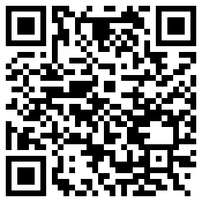
FBS-Radar & Baidu PhoneGuard
Baidu PhoneGuard
http://shoujiweishi.baidu.com
Crowdsourced data from ~100 Million Users

Slide 44
Database and List
WiFi MAC →
<lat, lon, tag>
BS ID →
<lat, lon, radius, tag>
≈ 1500 phone numbers

Slide 45
FBS-Radar: Timeline
2014.01-07
Design & Implementation
2014.08
Online released
2015
~17.5 million suspicious SMS messages reported per day
2016
~32 million suspicious SMS messages reported per day

Slide 46
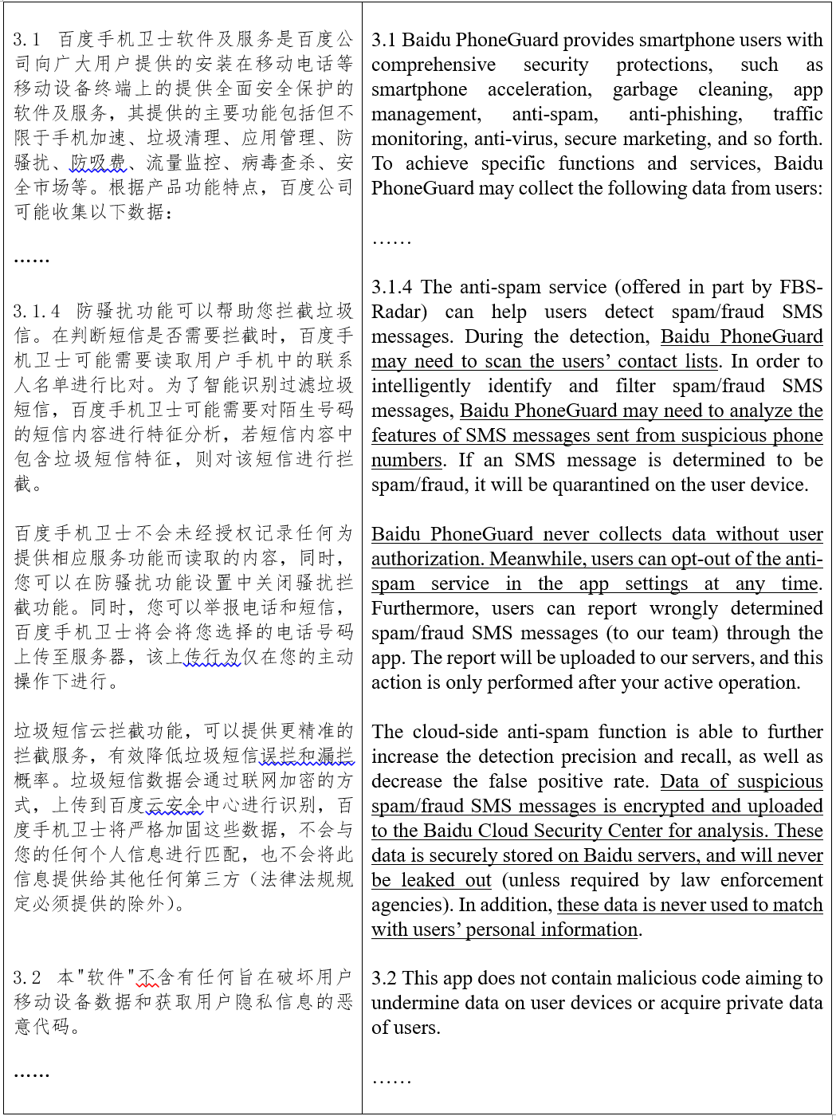
Informed Consent from Users

Slide 47
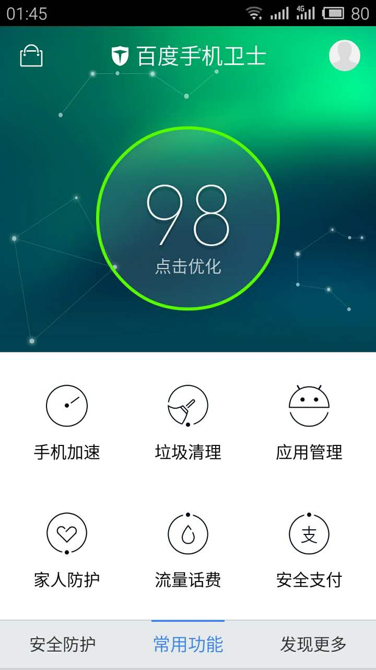
Opt-in Options for Users
Baidu PhoneGuard App

